Slide 1

Entrepreneurship: Successfully Launching New Ventures
Sixth Edition, Global Edition
Chapter 6
Writing a Business Plan
Notes:
If this PowerPoint presentation contains mathematical equations, you may need to check that your computer has the following installed:
1) MathType Plugin
2) Math Player (free versions available)
3) NVDA Reader (free versions available)

Slide 2
Learning Objectives
6.1 Explain the purpose of a business plan.
6.2 Describe who reads a business plan and what they are looking for.
6.3 Discuss the guidelines to follow to write an effective business plan.
6.4 Identify and describe a suggested outline of a business plan.
6.5 Explain how to effectively present a business plan to potential investors.

Slide 3
Step 1: Empathy Map & Define the Problem
Assign each team one of the following Extreme Users (or create your own):
The Global Digital Nomad: Lives out of one carry-on bag, constantly travels across multiple time zones, and relies entirely on shared workspaces and gig work.
The Zero-Waste Urban Minimalist: Lives in a tiny apartment, owns nothing disposable, and refuses to buy any product that requires new plastic packaging or long-distance shipping.
The Post-Pandemic Social Recluse: Works entirely from home, avoids public indoor spaces, and finds large group gatherings overwhelming, but desperately needs professional networking.
Empathy Mapping: The team fills out a quick Empathy Map for their assigned user:
What do they SEE? (Their physical environment, what they consume digitally).
What do they HEAR? (What friends, media, and experts tell them).
What do they THINK & FEEL? (Their core motivations, fears, and frustrations).
What do they DO? (Their daily routines, work habits, and purchasing behavior).
Problem Statement: Based on the map, the team defines a single, specific, and major pain point the user faces.
Example (Digital Nomad): "The Nomad is frustrated by inconsistent and insecure local Wi-Fi, making reliable communication for high-stakes video meetings impossible."

Slide 4
SCAMPER Prompt
Instruction
Example for Digital Nomad Wi-Fi Problem
Substitute
Replace a key part, material, or process.
Substitute a traditional internet service provider (ISP) connection with a distributed, satellite-mesh network using a portable, solar-powered device.
Combine
Merge it with another service or product.
Combine the device with a secure, decentralized digital notary service to immediately validate legal contracts signed during a meeting.
Adapt
Take an idea from another industry and apply it.
Adapt the system of air-traffic control signal redundancy to ensure the data stream never drops below a critical threshold.
Modify
Change the scale, color, shape, or motion.
Modify the form factor to be a modular, interlocking system of pucks that magnetically attach to various surfaces (walls, windows, car roofs) for optimal signal strength.
Put to another Use
Find a different purpose for the product.
Use the device's excess heat to charge other small electronics.
Eliminate
Remove unnecessary parts, costs, or steps.
Eliminate the need for any local SIM card, subscription, or local currency payment system.
Reverse
Do the opposite of what is normally expected.
Instead of the user accessing the internet, the internet access point finds the user using a predictive mobility algorithm.

Slide 5
Preliminary Feasibility & Business Model
The team quickly validates their new, radical idea using the concepts you've taught:
Feasibility Reality Check:
Desirability: Does the Extreme User find this solution desirable? (Yes, it solves their main pain point.) Can it be adapted to a broader, more common market? (This is the key pivot.)
Viability: Can the business make money? (What are the high-level revenue streams and cost structure?)
Competitive Snapshot (Chapter 5):
Direct/Indirect Competitors: Who else is solving this problem (even poorly)?
Value Proposition: What is the single, most powerful benefit that creates a sustainable competitive advantage?

Slide 6
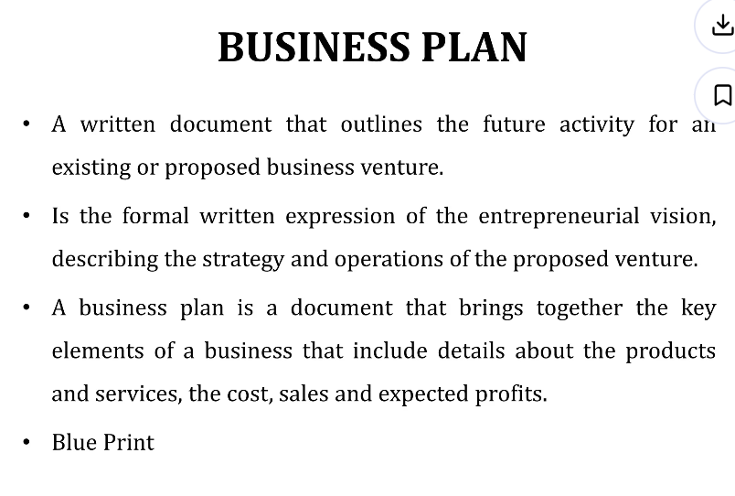

Slide 7
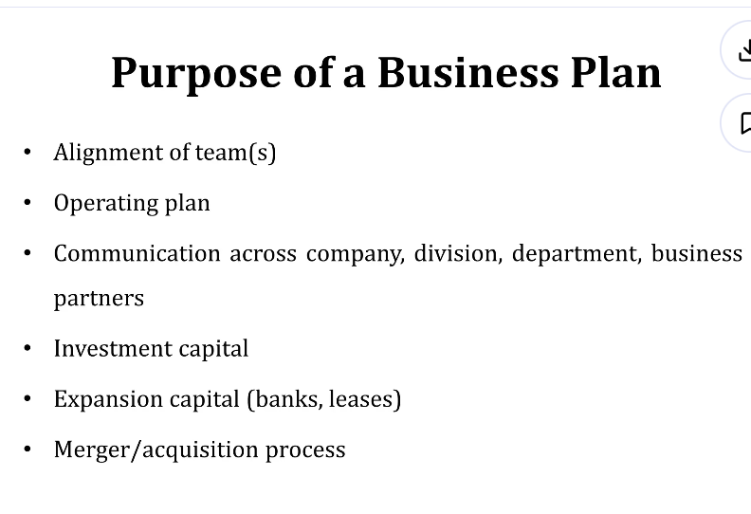

Slide 8
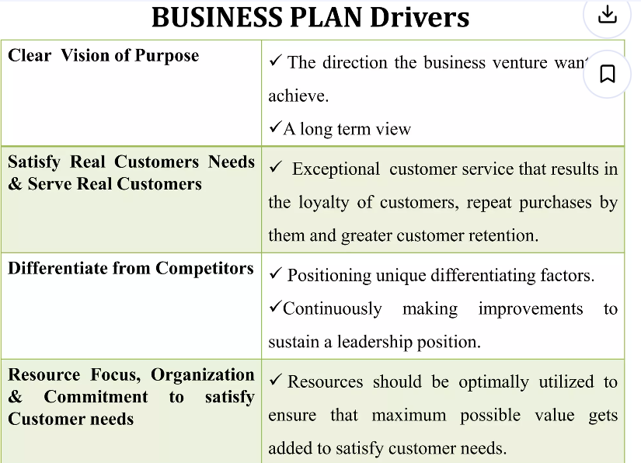

Slide 9
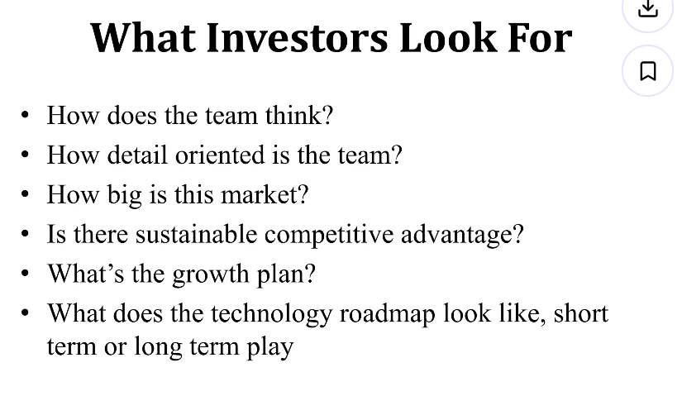

Slide 10
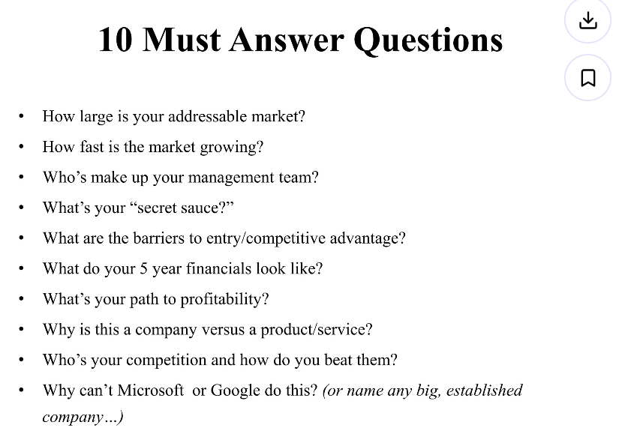

Slide 11
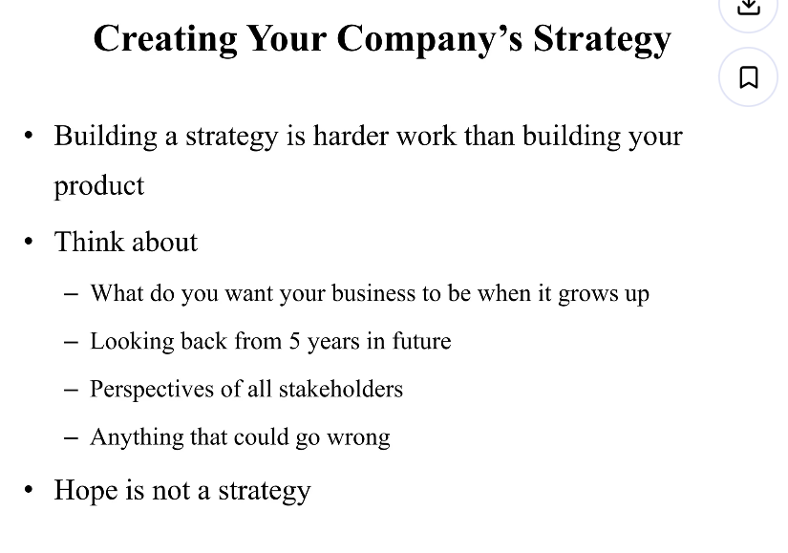

Slide 12


Slide 13


Slide 14
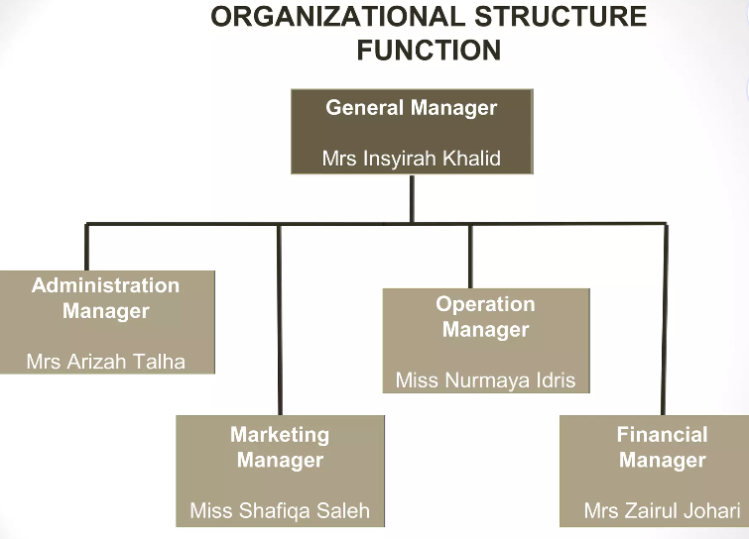

Slide 15
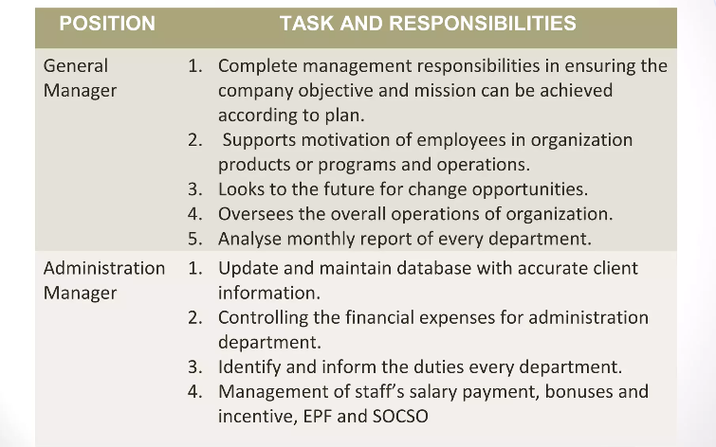

Slide 16
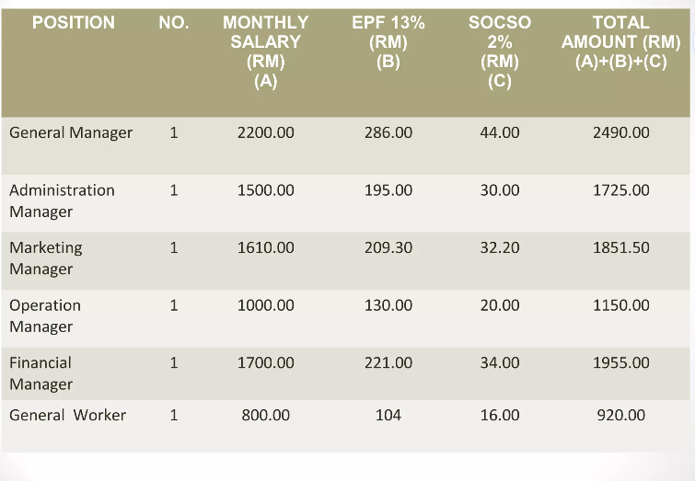

Slide 17
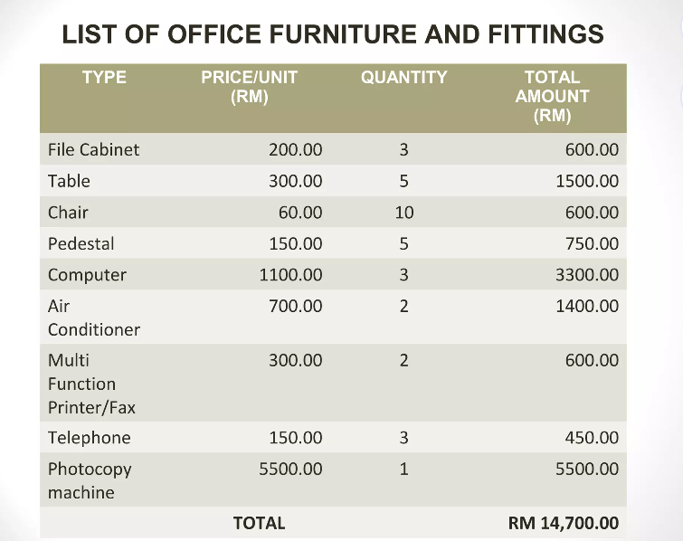

Slide 18
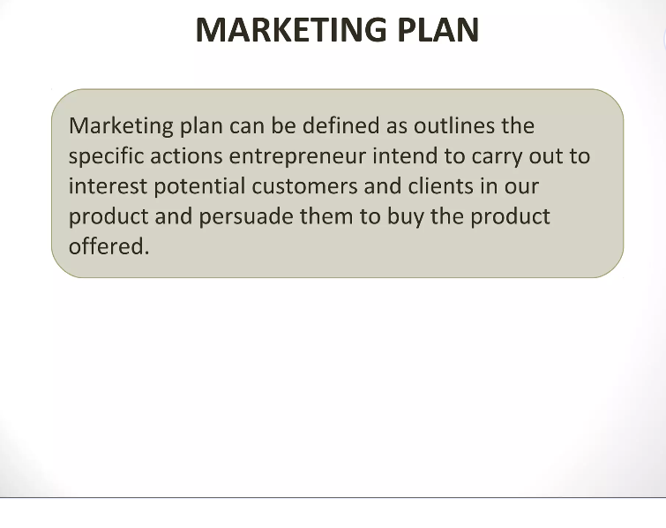

Slide 19
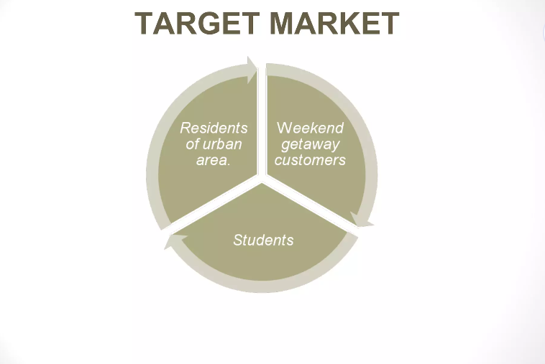

Slide 20
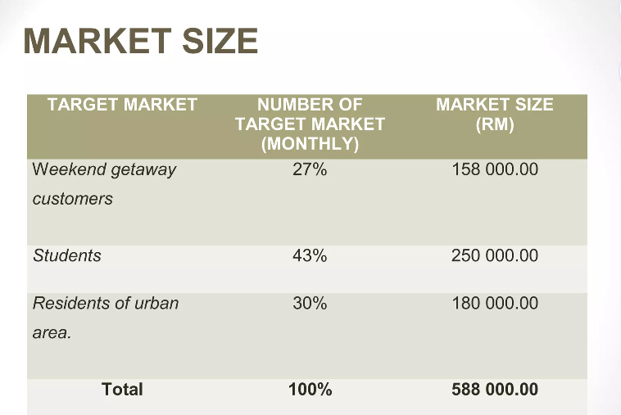

Slide 21
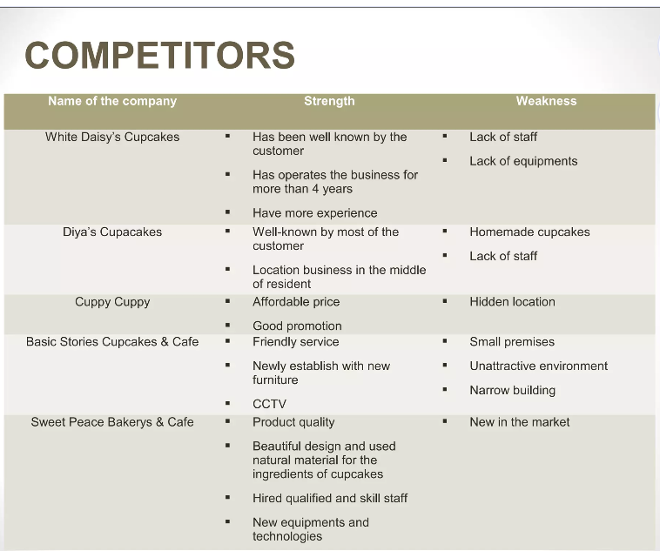

Slide 22
Divide groups of 3 Hand out three cards to each student (or 9 cards per team).
Each team member must write the following items, one page per team:
Card 1 (The Purpose): The single, most important reason investors read the Management Team section (Section 9).
Card 2 (The Insight): The key insight you should include in the Market Analysis section (Section 4) regarding your target market.
Card 3 (The Rule): The primary guideline to follow regarding the Structure of the overall business plan.
Teams swap their set of page with an adjacent team. The receiving team must evaluate the answers: * Correct? Give a 👍.
Missing key details? Give a and suggest a word to add (e.g., "strength of the people").

Slide 23
What Is a Business Plan?
Business Plan
A business plan is a written narrative, typically 25 to 35 pages long, that describes what a new business intends to accomplish and how it intends to accomplish it.
Dual-Use Document
For most new ventures, the business plan is a dual-purpose document that is used both inside and outside the firm.

Slide 24
Who Reads the Business Plan—and What Are They Looking For?
There are two primary audiences for a firm’s business plan
Audience | What They are Looking For
A Firm’s Employees | A clearly written business plan helps the employees of a firm operate in sync and move forward in a consistent and purposeful manner.
Investors and other external stakeholders | A firm’s business plan must make the case that the firm is a good use of an investor’s funds or the attention of others.

Slide 25
Guidelines for Writing a Business Plan (1 of 5)
Structure of the Business Plan
To make the best impression, a business plan should follow a conventional structure, such as the outline for the business plan shown in the chapter.
Although some entrepreneurs want to demonstrate creativity, departing from the basic structure of the conventional business plan is usually a mistake.
Typically, investors are busy people and want a plan where they can easily find critical information.

Slide 26
Guidelines for Writing a Business Plan (2 of 5)
Software Packages
There are many software packages available that employ an interactive, menu-driven approach to assist in the writing of a business plan.
Some of these programs are very helpful. However, entrepreneurs should avoid a boilerplate plan that looks as though it came from a “canned” source.
Sense of Excitement
Along with facts and figures, a business plan needs to project a sense of anticipation and excitement about the possibilities that surround a new venture.

Slide 27
Guidelines for Writing a Business Plan (3 of 5)
Content of the Business Plan
The business plan should give clear and concise information on all the important aspects of the proposed venture.
It must be long enough to provide sufficient information yet short enough to maintain reader interest.
For most plans, 25 to 35 pages is sufficient.
Types of Business Plans
There are three types of business plans, which are shown on the next slide.

Slide 28
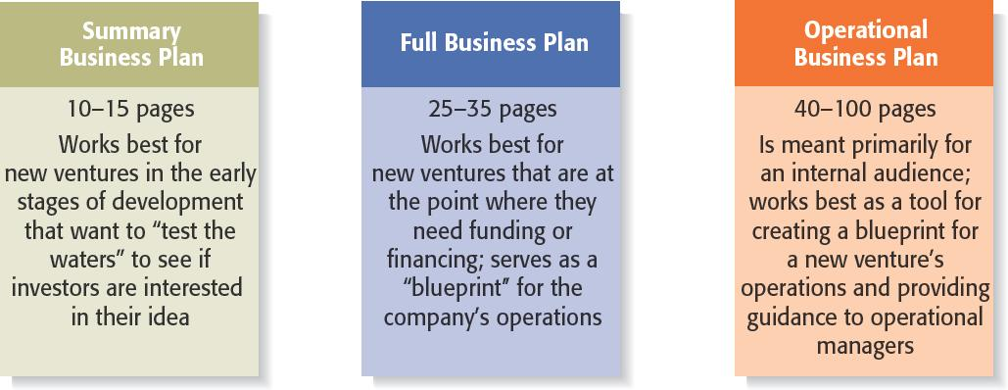
Guidelines for Writing a Business Plan (4 of 5)
Figure 6.2 Types of Business Plans

Slide 29
Guidelines for Writing a Business Plan (5 of 5)
Recognizing the Elements of the Plan May Change
It’s important to recognize that the plan will usually change while written.
New insights invariably emerge when an entrepreneur or a team of entrepreneurs immerse themselves in writing the plan and start getting feedback from others.

Slide 30
Outline of Business Plan
A suggested outline of a business plan is shown on the next several slides.
Most business plans do not include all the elements introduced in the sample plan; we include them here for the purpose of completeness.
Each entrepreneur must decide which elements to include in his or her plan.

Slide 31
Section 1: Executive Summary (1 of 2)
Executive Summary
The executive summary is a short overview of the entire business plan.
It provides a busy reader with everything that needs to be known about the new venture’s distinctive nature.
An executive summary shouldn’t exceed two single-spaced pages.
Even though the executive summary appears at the beginning of the business plan, it should be written last.
The plan itself will evolve as it’s written, so not everything is known at the outset.

Slide 32
Section 1: Executive Summary (2 of 2)
Key Insights
In many instances an investor will first ask for a copy of the firm’s PowerPoint deck or executive summary and will request of a copy of the full business plan only if the PowerPoint deck or executive summary is sufficiently convincing.
The executive summary, then, is arguably the most important section of a business plan.

Slide 33
Section 2: Industry Analysis (1 of 2)
Industry Analysis
This section should begin by describing the industry the business will enter in terms of its size, growth rate, and sales projections.
Items to include in this section:
Industry size, growth rate, and sales projections.
Industry structure.
Nature of participants.
Key success factors.
Industry trends.
Long-term prospects.

Slide 34
Section 2: Industry Analysis (2 of 2)
Key Insights
Before a business selects a target market it should have a good grasp of its industry—including where its promising areas are and where its points of vulnerability are.
The industry that a company participates in largely defines the playing field that a firm will participate in.

Slide 35
Section 3: Company Description (1 of 2)
Company Description
This section begins with a general description of the company.
Items to include in this section:
Company description.
Company history.
Mission statement.
Products and services.
Current status.
Legal status and ownership.
Key partnerships (if any).

Slide 36
Section 3: Company Description (2 of 2)
Key Insights
While at first glance this section may seem less important than the others, it is extremely important.
It demonstrates to your reader that you know how to translate an idea into a business.

Slide 37
Section 4: Market Analysis (1 of 2)
Market Analysis
The market analysis breaks the industry into segments and zeroes in on the specific segment (or target market) to which the firm will try to appeal.
Items to include in this section:
Market segmentation and target market selection.
Buyer behavior.
Competitor analysis.
Estimate of the firm’s annual sales and market share.

Slide 38
Section 4: Market Analysis (2 of 2)
Key Insights
Most start-ups do not service their entire industry. Instead, they focus on servicing a specific (target) market within the industry.
It’s important to include a section in the market analysis that deals with the behavior of the consumers in the market. The more a start-up knows about the consumers in its target market, the more it can tailor its products or services appropriately.

Slide 39
Section 5: The Economics of the Business (1 of 2)
The Economics of the Business
This section addresses the basic logic of how profits are earned in the business and how many units of a business’s profits must be sold for the business to “break even” and then start earning a profit.
Items to include in this section:
Revenue drivers and profit margins.
Fixed and variable costs.
Operating leverage and its implications.
Start-up costs.
Break-even chart and calculations.

Slide 40
Section 5: The Economics of the Business (2 of 2)
Key Insights
Two companies in the same industry may make profits in different ways. One may be a high-margin, low-volume business, while the other may be a low-margin, high-volume business. It’s important to check to make sure the approach you select is sound.
Computing a break-even analysis is an extremely useful exercise for any proposed or existing business.

Slide 41
Section 6: Marketing Plan (1 of 2)
Marketing Plan
The marketing plan focuses on how the business will market and sell its product or service.
Items to include in this section:
Overall marketing strategy.
Product, price, promotions, and distribution.
Sales process (or cycle).
Sales tactics.

Slide 42
Section 6: Marketing Plan (2 of 2)
Key Insights
The best way to describe a start-up’s marketing plan is to start by articulating its marketing strategy, positioning, and points of differentiation, and then talk about how these overall aspects of the plan will be supported by price, promotional mix, and distribution strategy.
It’s also important to discuss the company sales process.

Slide 43
Section 7: Product (or Service) Design and Development Plan (1 of 2)
Design and Development Plan
If you’re developing a completely new product or service, you need to include a section in your business plan that focuses on the status of your development efforts.
Items to include in this section:
Development status and tasks.
Challenges and risks.
Projected development costs.
Proprietary issues (patents, trademarks, copyrights, licenses, brand names).

Slide 44
Section 7: Product (or Service) Design and Development Plan (2 of 2)
Key Insights
Many seemingly promising start-ups never get off the ground because their product development efforts stall or the actual development of the product or service turns out to be more difficult than thought.
As a result, this is a very important section for businesses developing a completely new product or service.

Slide 45
Section 8: Operations Plan (1 of 2)
Operations Plan
Outlines how your business will be run and how your product or service will be produced.
A useful way to illustrate how your business will be run is to describe it in terms of “back stage” (unseen to the customer) and “front stage” (seen by the customer) activities.
Items to include in this section:
General approach to operations.
Business location.
Facilities and equipment.

Slide 46
Section 8: Operations Plan (2 of 2)
Key Insights
Your have to strike a careful balance between adequately describing this topic and providing too much detail.
As a result, it is best to keep this section short and crisp.

Slide 47
Section 9: Management Team and Company Structure (1 of 2)
Management Team and Company Structure
The management team of a new venture typically consists of the founder or founders and a handful of key management personnel.
Items to include in this section:
Management team.
Board of directors (if you have one).
Board of advisors (if you have one).
Company structure.

Slide 48
Section 9: Management Team and Company Structure (2 of 2)
Key Insights
This is a critical section of a business plan.
Many investors and others who read the business plan look first at the executive summary and then go directly to the management team section to assess the strength of the people starting the firm.

Slide 49
Section 10: Overall Schedule (1 of 2)
Overall Schedule
A schedule should be prepared that shows the major events required to launch the business.
The schedule should be in the format of milestones critical to the business’s success.
Examples of milestones:
Incorporating the venture.
Completion of prototypes.
Rental of facilities.
Obtaining critical financing.
Starting production.
Obtaining the first sale.

Slide 50
Section 10: Overall Schedule (2 of 2)
Key Insight
An effectively prepared and presented schedule can be extremely helpful in convincing potential investors that the management team is aware of what needs to take place to launch the venture and has a plan in place to get there.

Slide 51
Section 11: Financial Projections (1 of 2)
Financial Projections
The final section of a business plan presents a firm’s pro forma (or projected) financial projections.
Items to include in this section:
Sources and uses of funds statement.
Assumptions sheet.
Pro forma income statements.
Pro forma balance sheets.
Pro forma cash flows.
Ratio analysis.

Slide 52
Section 11: Financial Projections (2 of 2)
Key Insights
Having completed the earlier sections of the plan, it’s easy to see why the financial projections come last.
They take the plans you’ve developed and express them in financial terms.

Slide 53
Presenting the Business Plan to Investors (1 of 2)
The Oral Presentation
The first rule in making an oral presentation is to follow directions. If you’re told you have 20 minutes, don’t talk for more than the allotted time.
The presentation should be smooth and well-rehearsed.
The slides should be sharp and not cluttered.
Questions and Feedback to Expect from Investors
The smart entrepreneur has a good idea of the questions that will be asked, and will be prepared for those queries.

Slide 54
Presenting the Business Plan to Investors (2 of 2)
Twelve PowerPoint Slides to Include in an Investor Presentation
Title Slide
Problem
Solution
Opportunity and target market
Technology
Competition
Marketing and sales
Management team
Financial projections
Current status
Financing sought
Summary

Slide 55
The End

